Slide 1


FINAL SUBMISSION
CareLink
NFC-Powered Maternal Health Platform —
AI Record Digitization, RAG Smart Entry & Secure Handoff
TEAM NAME :-WildFire
TEAM CODE O2S22M
₹50 band. One tap. Every mother's story — safe.
HEALTH-A-THON 2026 • TITLE

Slide 2
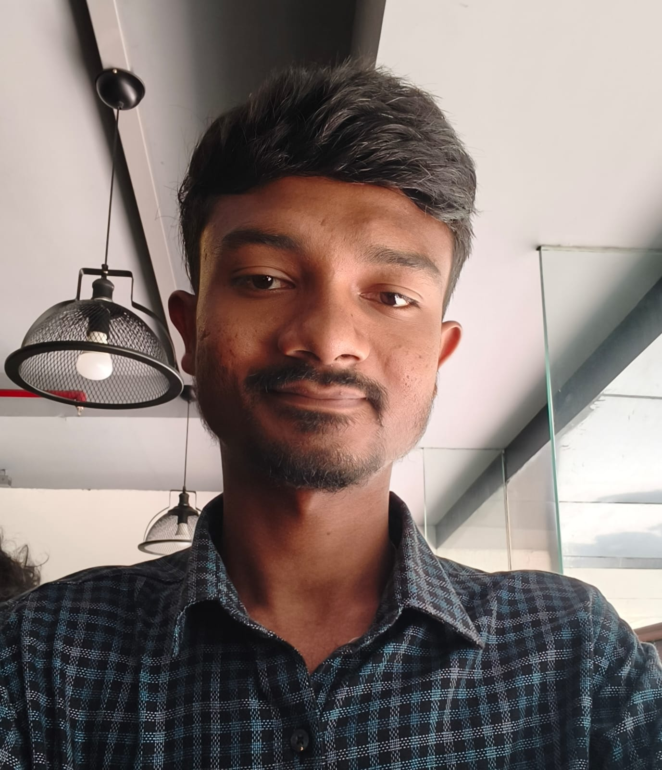
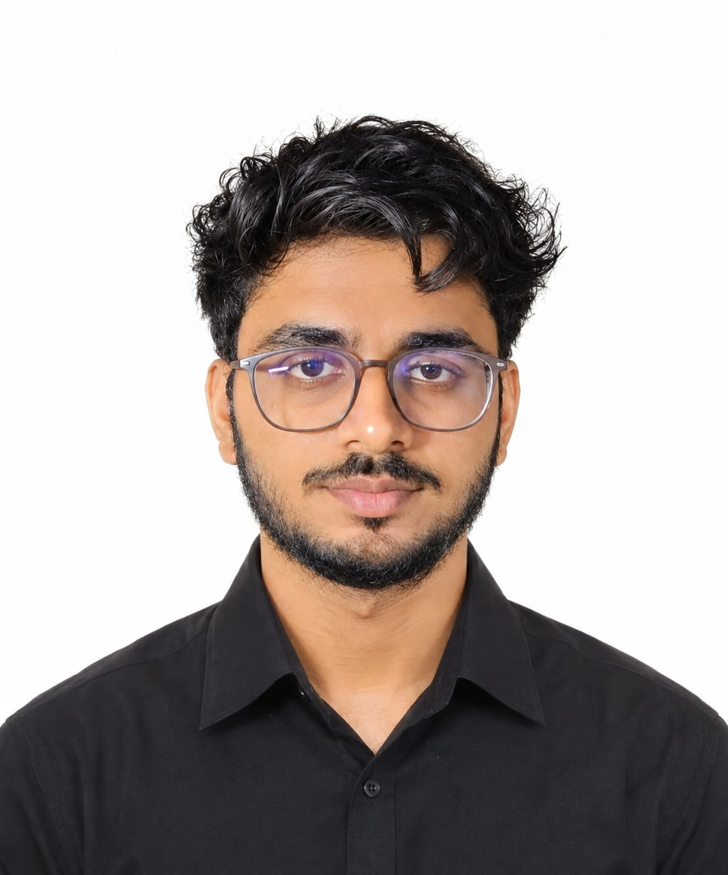
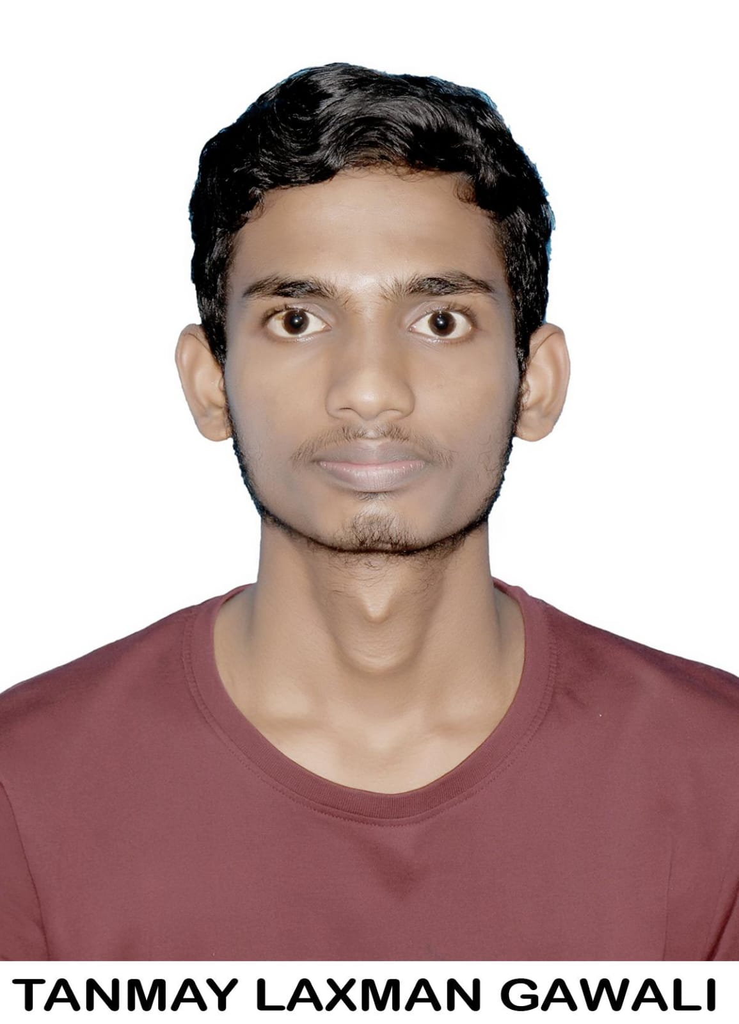
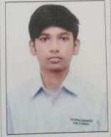
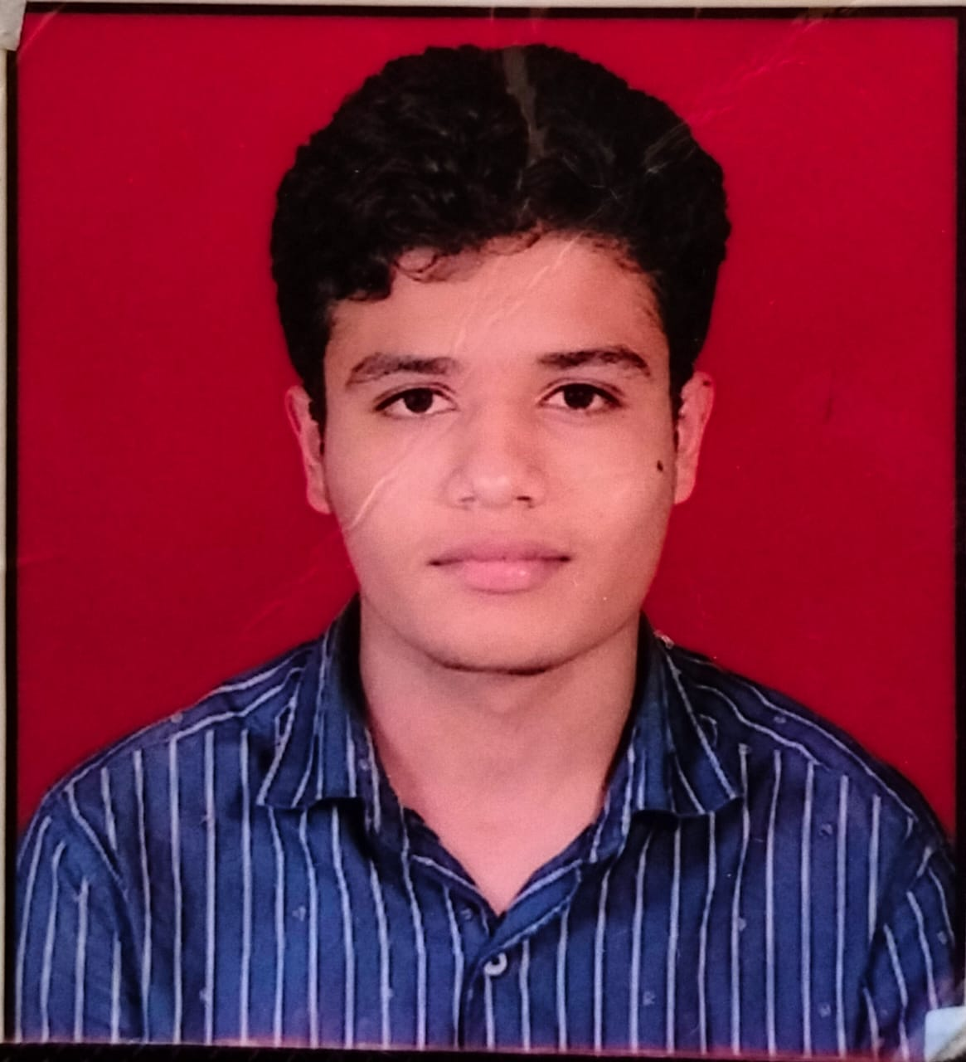
Team Overview & Background
ENGINEERING TEAM
CLINICAL ADVISOR
🔥 Siddharth Jamdhade
Team Lead · System Architect · AI Pipeline
3rd Year B.Tech IoT, YCCE Nagpur
💻 Abhay Harne
Frontend Developer · Doctor Portal UI
3rd Year B.Tech IoT, YCCE Nagpur
PHOTO
PHOTO
PHOTO
🩺 Dr. Tanmay Gawali
Clinical Advisor · ANC Protocol Validator
MBBS Intern, Lokmanya Tilak Municipal
Medical College (LTMMC), Mumbai
React portal, patient dashboard, 9-column care view
Full-stack build: Gemini AI, OCR, RAG, cloud deployment
⚙️ Anaghraj Singh Thakur
Backend Developer · RAG & Database
3rd Year B.Tech IoT, YCCE Nagpur
🔌 Rajveer Rajput
IoT & Hardware Engineer
3rd Year B.Tech IoT, YCCE Nagpur
PHOTO
PHOTO
Role in CareLink:
• Validated AI extraction accuracy
against clinical standards
• Reviewed & approved pregnancy knowledge base
(15 templates)
• Designed ANC protocol compliance rules
(MoHFW 4-visit schedule)
• Safety oversight: ensured AI never makes
clinical decisions
• Tested doctor verification workflow
for edge cases
FastAPI, ChromaDB, knowledge base, verification queue
ESP32-C3, RFID-RC522 scanner, NFC wristband integration
🏫 Yeshwantrao Chavan College of Engineering (YCCE), Nagpur
Rashtrasant Tukadoji Maharaj Nagpur University
Department: IoT (Internet of Things)
HEALTH-A-THON 2026 • FINAL SUBMISSION
Notes:
Team member names, academic affiliations, engineering contributions and clinical-advisor activities are supplied by the user. The slide describes the stated project roles and does not independently certify credentials or clinical validation results.

Slide 3

Problem Statement and Supporting Evidence
Missing records. Delayed decisions. Mothers at risk.
7.2%
of global maternal deaths
India • 2023
Illustrative ANC card • Synthetic sample
The Problem
Why Current Solutions Fail
❌
Paper ANC cards lost or damaged
📄
Paper records need digital conversion
❌
Referral teams lack prior patient history
✍️
Handwriting needs structured extraction
❌
Repeated questions delay consultations
👩‍⚕️
PHC nurses need assisted data entry
❌
Emergency handoffs lack patient history
WHO et al., 2025 • Estimates for 2023
HEALTH-A-THON 2026 • FINAL SUBMISSION
Notes:
WHO et al. (2025), Trends in maternal mortality 2000 to 2023. India: 7.2% of global maternal deaths in 2023.
https://www.who.int/publications/i/item/9789240108462/
Image: user-supplied synthetic ANC card illustration. Workflow bullets describe problem framing, not measured prevalence or an exhaustive market assessment. Mortality burden is context, not deaths attributed to missing records.

Slide 4

Target Users and Use Case
👩‍⚕️
👨‍⚕️
🏥
Nurses / ANMs
PHC / CHC Doctors
Referral Hospital Doctors
Feeds data
Verifies cases
Scans QR
Tap → preloaded form
Flags + summaries
Patient history
🏷️ ₹50 NFC WRISTBAND — The Core Product
Every patient gets one at registration
Nurse taps scanner → record auto-loads
No manual ID. No barcodes. One tap.
₹50 NFC Band + RFID-RC522 Scanner — built in-house
Illustrative case: Lakshmi, 26 • 32 weeks
Severe headache • District Hospital • Paper records at home
WITHOUT CareLink
WITH CareLink
✕ Paper records unavailable
✓ QR scan retrieves pregnancy history
✓ 30-second history access target
✕ Missing history slows assessment
🏷️ Tap wristband → patient ID auto-loaded
HEALTH-A-THON 2026 • FINAL SUBMISSION
Notes:
Illustrative fictional case supplied by user. Thirty-second history retrieval is a performance target, not a measured result. No quantified treatment-delay reduction or immediate treatment outcome is claimed. Support staff may assist data entry within local role permissions.

Slide 5


Solution Overview — Two Portals, One Band
🏷️
🖥️
📱
NFC Wristband (₹50)
Doctor Portal (Website)
Patient App
•
Silicone band with NFC chip
•
Password-protected workspace
•
Unique ID + password
at registration
•
Given at registration
•
Patient directory + search
•
Tap scanner → auto-identify
•
9 columns: Labs, USG, ABHA,
Supplements, etc.
•
Pregnancy progress tracker
•
Links to cloud patient record
•
EDD, diet plans, 3D baby view
•
Cost: ₹50 per band
•
RAG-assisted data entry
•
Appointment reminders
•
Doctor review queue
•
Private: sees ONLY own data
•
Upload + AI extraction
App — Under Development
Portal account creation proof
CareLink = ₹50 Band + Doctor Portal + Patient App + AI Engine
HEALTH-A-THON 2026 • FINAL SUBMISSION
Notes:
Feature descriptions supplied by user. Unverified 80/20 ratios and two-versus-fifteen-minute claims omitted. Self-learning represents the proposed doctor-feedback loop, not demonstrated autonomous model retraining. Illustration generated with the built-in imagegen tool; conceptual patient identification visual, not a technical NFC range diagram. QR code is illustrative.

Slide 6

CareLink Workflow & Target Impact
🏷️ NFC WRISTBAND
Patient taps scanner
CARELINK AI
📸 Upload Photo
PaddleOCR
Gemini 2.5
🎤 Voice Input
RAG Pipeline
🖥️ DOCTOR PORTAL
📱 PATIENT APP
9 record columns
Pregnancy dashboard
✅ RAG match → Verified → stored to columns
🔄 New info → Doctor review → RAG learns
Care at a glance
TARGET IMPACT • Pilot validation pending
87%
100%
30 sec
Self-Learning
Faster Entry
Digital
Handoff
HEALTH-A-THON 2026 • FINAL SUBMISSION
Notes:
Target impact, not measured clinical or deployment results. Fifteen to two minutes is an 86.7% reduction in entry time, rounded to 87%, not an 87% increase in entry speed. 100% refers to the proposed digitization target, not proven nationwide record availability. Thirty seconds is a QR access target. Self-learning describes the proposed doctor-approval feedback loop; automatic learning and daily improvement are not demonstrated. The 40% consultation-time reduction was not included because no supporting evaluation was supplied. NFC retrieves an identifier and looks up the associated record; it does not extract clinical history from the wristband. PN532 is the NFC reader; ESP32-C3 is its controller. Both images are AI-generated illustrations, not actual prototype or deployment photographs. Photo and voice outputs must be reviewed by the doctor before QR handoff.

Slide 7

Technology & AI Approach
TECH STACK
SYSTEM ARCHITECTURE
Component | Technology
⭐ NFC Hardware | ₹50 silicone band + RFID-RC522 + ESP32-C3
Doctor Portal | React 19, Framer Motion
Patient App | Under development
Backend | Python 3.12, FastAPI, SQLAlchemy
Database | SQLite + Cloud sync
OCR | PaddleOCR (offline, handwriting)
AI Model | Gemini 2.5 Flash (multimodal)
RAG Pipeline | ChromaDB + Gemini Embeddings
Voice | Sarvam AI (Hindi/Marathi)
NFC
Band
RFID-RC522
+ ESP32
FastAPI
Backend
AI Layer
Doctor Portal
Patient App
RFID-RC522 scanner (₹1,500) + NFC band (₹50)
⚠️ AI extracts data ONLY. It NEVER diagnoses or prescribes.
HEALTH-A-THON 2026 • FINAL SUBMISSION
Notes:
User-supplied technology stack and hardware prices. Actual scanner and wristband photographs supplied by user. Simplified logical architecture with Doctor Portal and Patient App outputs. Patient App is under development. AI extracts data only and never diagnoses or prescribes. Handwriting recognition is listed as supplied; accuracy was not evaluated here.

Slide 8


Build Sprint Journey & Progress
WEEK 1
WEEK 2
WEEK 3
WEEK 4
Foundation
Intelligence Layer
RAG + NFC Hardware
Portals + Integration
✓
FastAPI + SQLite
✓
Three conflict checks
✓
15 knowledge base
templates
✓
Doctor Portal: directory
+ 9 record columns
✓
PaddleOCR integration
✓
MoHFW ANC checker
✓
ChromaDB + RAG
pipeline
✓
NFC band → scanner →
patient auto-load
✓
Gemini AI extraction
✓
Confidence + review
✓
ESP32 + RFID-RC522
NFC scanner prototype
✓
Patient account
creation (unique ID)
✓ Completed milestones
↻ Patient App +
Sarvam voice —
in progress
AI-extracted structured data
from handwritten ANC card
Auto-flags missing ANC records
against MoHFW protocol
SOLUTION EVOLUTION
OCR only
OCR+AI
OCR+AI+RAG
Full Platform (Band + Portal + App)
HEALTH-A-THON 2026 • FINAL SUBMISSION
Notes:
User-reported four-week build milestones, not independently audited. Patient App and Sarvam voice remain in progress. Week 1 extraction-table screenshot and Week 2 ANC-flags screenshot are supplied by the user and cropped to relevant evidence. MoHFW protocol checking is presented as the supplied implementation description; this slide does not independently validate clinical guideline adherence or extraction accuracy. The final evolution stage describes the full platform direction, including the app still in progress.

Slide 9
Evaluation & User Validation
REPORTED PROTOTYPE RESULTS
Metric | Result
Fact extraction accuracy | 85–92%
Tested conflict types detected | 100%
RAG template match rate | 80%
False doctor referral | <5%
Data entry time reduction | 87%
NFC tap → record load | <3 sec
LIVE SYSTEM
VALIDATION
👨‍⚕️
DOCTOR FEEDBACK
✅
4 patients registered
successfully
“QR code handoff is the
most practical feature — full
history before patient enters
my room”
✅
Patient credentials
generated securely
✅
9 record columns functional
✅
NFC wristband →
auto-identification working
✅
RAG data entry →
form pre-fill working
LIMITATIONS
✅
Doctor review queue →
cases flagged correctly
⚠️
Faded documents reduce OCR quality
20+ synthetic ANC images • 15 RAG scenarios
3 conflict types • MoHFW protocol checks
⚠️
Pregnancy-only knowledge base
IMPROVEMENTS MADE
✅ Emergency danger signs: manual entry
⚠️
Real PHC scale untested
🟢 🟡 🔴 Confidence badges for review
✅ Routine nurse clicks: 12 → 3
⚠️
Patient App under development
HEALTH-A-THON 2026 • FINAL SUBMISSION
Notes:
Prototype metrics, doctor quotation and live-system validation checklist are user-reported. Raw logs, timing measurements, denominators and evaluation procedures were not supplied. Existing reported scope: 20+ synthetic ANC images, 15 RAG scenarios, three tested conflict types and MoHFW protocol checks. The under-three-second NFC load result and successful portal checks are supplied by the user, not independently measured here. Secure credential generation is a user-supplied assertion, not a security audit conclusion. Existing extraction, RAG, referral and entry-time figures retain their reported scope. Patient App remains under development; real PHC-scale testing remains incomplete.

Slide 10
Safety & Responsible AI
🔒 Data Privacy
⚠️ AI Limitations
👁️ Human Oversight
• Consent before digitization
• SQLite + cloud AI processing
• OCR → UNVERIFIED facts
AI
suggests
Nurse
reviews
Doctor
verifies
• Redaction + training: verify
🔒
NFC band stores ONLY a unique link —
no medical data on the band
• Hallucinations → source checks
🔒
Band is useless without hospital scanner
+ authenticated portal
Flagged cases → doctor
• RAG mismatch → doctor review
🔒
Patient App shows ONLY their own data
— no cross-patient access
Corrections → knowledge base
NON-NEGOTIABLE SAFETY RULES
🚫 AI NEVER diagnoses, prescribes, or scores risk.
🚫 Human confirmation before record finalization.
🚫 Detected danger signs → 0% match confidence → doctor.
♿ Hindi/Marathi voice: in progress • Large buttons • Low-end phones • Offline OCR; cloud AI/voice online
♿ ₹50 band — affordable for all economic backgrounds
♿ NFC = no literacy needed — just tap
HEALTH-A-THON 2026 • FINAL SUBMISSION
Notes:
Safety wording checked against local source. llm_extractor.py sends full image bytes and OCR text to Gemini and permits verbatim transcription of explicitly documented diagnoses, symptoms and medications while prohibiting inference, treatment advice and numerical clinical measurements. No image redaction is evident in that extraction path; no provider no-training guarantee was verified. records.py saves extracted facts as unverified or conflict drafts before human verification, so never auto-saves is inaccurate. rag_pipeline.py forces retrieval confidence to zero and doctor routing when configured danger signs are detected; this is not a clinical risk score or guarantee of detecting all emergencies. RAG confirmation requires review, with flagged cases routed to the doctor. Voice support is in progress per user; cloud AI and cloud transcription need connectivity. Privacy safeguards still requiring implementation or contractual verification are visibly marked.

Slide 11
Deployment, Cost & Sustainability
INDICATIVE PILOT BUDGET
PROPOSED SCALE-UP
₹50/patient
1 PHC Pilot
Nagpur • 3 months
₹50/patient + ₹1,300/month =
Complete maternal health digitization
5 PHCs
ONE-TIME SETUP
Includes first-year domain
Setup item | Budget
NFC wristband (per patient) | ₹50
RFID-RC522 scanner (per facility) | ₹1,500
Server setup (Render free) | ₹0
Domain name | ₹800/year
Staff training | ₹2,000 one-time
TOTAL per facility | ~₹4,300 + ₹50/patient
Maharashtra • 6 months
State Rollout
Proposed NHM partnership
National Open-Source
Adoption + implementation partners
MONTHLY RUNNING COSTS
Component | Budget / month
Gemini API | ₹0–500
Sarvam voice | ₹0–300
Pilot hosting | ₹0–500
PHC computer + internet • Android phone
Hospital server / paid hosting • NFC enabled
Sustainability: low costs + open-source + partners
HEALTH-A-THON 2026 • FINAL SUBMISSION
Notes:
All costs are user-supplied indicative pilot planning estimates, not provider quotations or measured facility spending. Fixed first-year facility setup: scanner INR 1500 + server setup INR 0 + first-year domain INR 800 + staff training INR 2000 = INR 4300. Add INR 50 for each patient wristband. Domain renews annually at the listed INR 800 estimate. Monthly maximum from retained components: Gemini INR 500 + Sarvam INR 300 + pilot hosting INR 500 = INR 1300. The requested complete digitization callout is a simplified budget summary; it does not independently establish an all-inclusive production cost. Existing devices, staff time, internet, durable storage, backups, security, support and taxes are excluded from these listed line items. Render free setup is a user-supplied pilot assumption; provider terms and prices were not checked for this edit. Scale-up milestones and NHM partnership remain proposed.

Slide 12

What Next? CareLink Roadmap
3 Months
6–12 Months
Long-term Vision
•
Complete Patient App
(pregnancy tracker, EDD,
3D baby)
•
ABDM / ABHA integration
•
National open-source platform
•
DigiLocker document
verification
•
NHM Maharashtra partnership
•
Sarvam AI voice integration
•
Multi-language: Hindi,
Marathi, Telugu, Tamil
•
TB, diabetes + pediatrics
•
Nagpur PHC pilot with
real patients
•
SMS/WhatsApp appointment
reminders
PHC Pilot → State Scale → NATIONAL OPEN SOURCE PLATFORM
https://github.com/Siddharth-Jamdhade/CareLink
HEALTH-A-THON 2026 • FINAL SUBMISSION
Notes:
Roadmap supplied by user. Three-month, 6-12-month and long-term items are planned, not delivered functionality or secured partnerships. ABDM integration is proposed; no certification or approval claimed. Offline-first/zero-connectivity PWA does not imply cloud Gemini or cloud speech transcription can operate offline. ESP32 live vitals capture requires appropriate sensors, engineering validation and clinician review; current NFC wristband is identification hardware, not a validated vital-sign monitor. National-first novelty claim omitted because it was not substantiated. Open-source release is a commitment supplied by user. Repository URL https://github.com/Siddharth-Jamdhade/CareLink was supplied by user; public availability and license could not be verified in this session. Columns and roadmap arrow are editable native PowerPoint shapes, not native SmartArt.

Slide 13
Thank you
WildFire • O2S22M
Website: carelink-hospital-portal-sj.jamdhadesiddharth69.chatgpt.site
Demo: [YouTube link]
GitHub: github.com/Siddharth-Jamdhade/CareLink
Email: jamdhadesiddharth69@gmail.com
₹50 band. One tap. Every mother's story — safe, digital, connected.
HEALTH-A-THON 2026

